Slide 1
By:
S. Sarath Adhithya
Topic: Automatic Irrigation System

Slide 2
Moisture Sensor Circuit Code:
int sensorPin = A0;
int sensorValue;
int limit = 400;
void setup() {
Serial.begin(9600);
pinMode(13, OUTPUT);
}
void loop() {
sensorValue = analogRead(sensorPin);
Serial.println("Analog Value : ");
Serial.println(sensorValue);
if (sensorValue<limit) {
digitalWrite(13, HIGH);
}
else {
digitalWrite(13, LOW);
}
delay(1000);
}

Slide 3
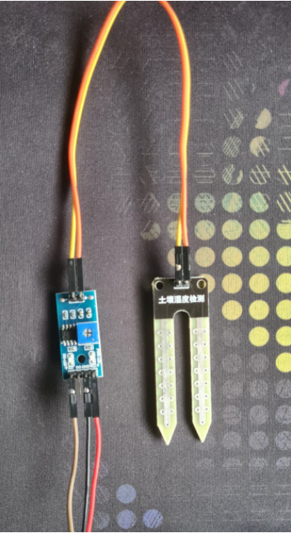
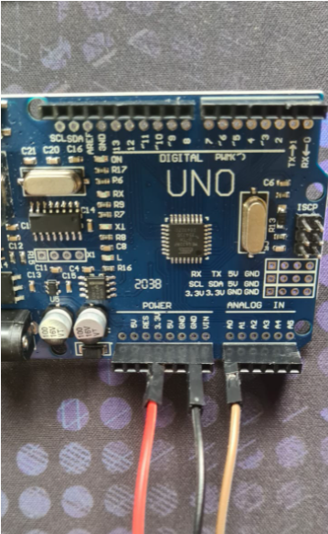
Sensor Circuit Connections:

Slide 4
OLED Circuit Code:
#include <Wire.h>
#include <Adafruit_GFX.h>
#include <Adafruit_SSD1306.h>
#define SCREEN_WIDTH 128 // OLED display width, in pixels
#define SCREEN_HEIGHT 64 // OLED display height, in pixels
// Declaration for an SSD1306 display connected to I2C (SDA, SCL pins)
Adafruit_SSD1306 display(SCREEN_WIDTH, SCREEN_HEIGHT, &Wire, -1);
void setup() {
Serial.begin(115200);
if(!display.begin(SSD1306_SWITCHCAPVCC, 0x3C)) {
// Address 0x3D for 128x64
Serial.println(F("SSD1306 allocation failed"));
for(;;);
}
delay(2000);
display.clearDisplay();
display.setTextSize(1);
display.setTextColor(WHITE);
display.setCursor(0, 10); // Display static text
display.println("Hello, world!");
display.display();
}
void loop() {
}

Slide 5
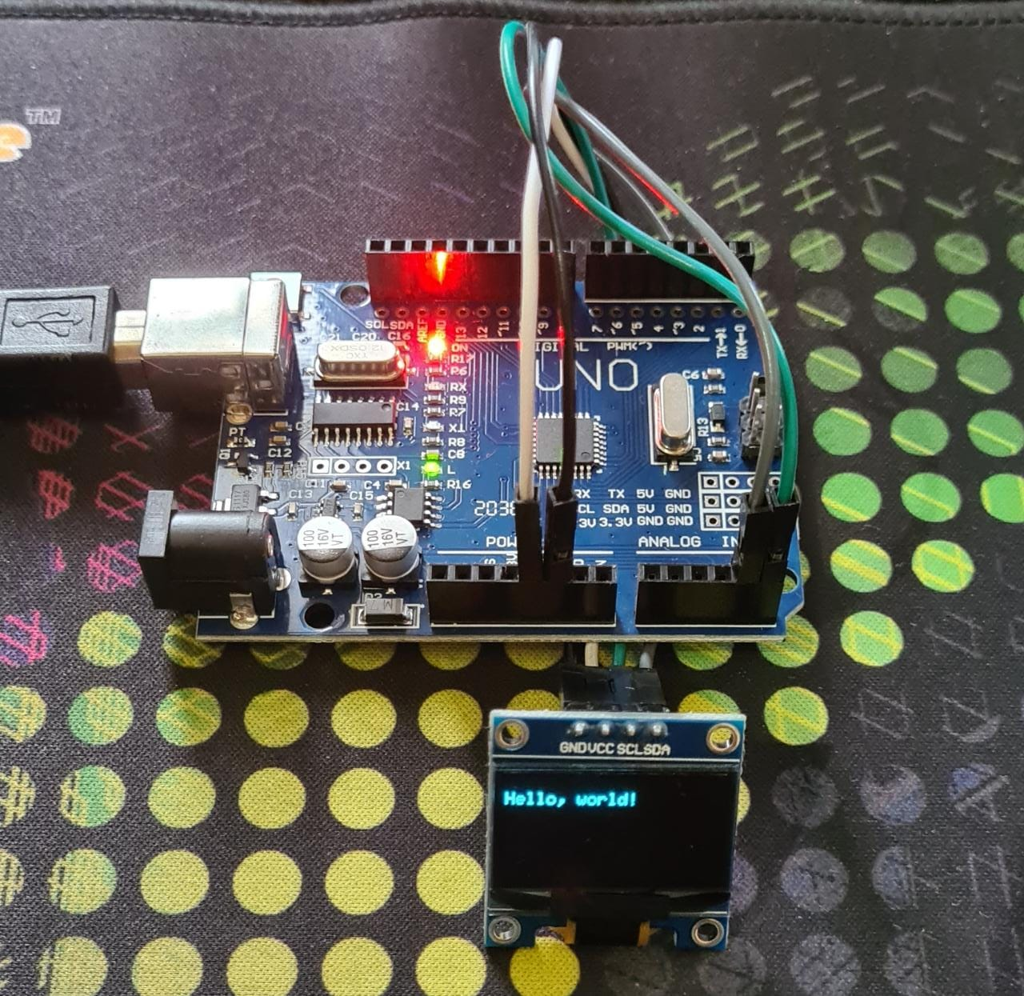
OLED Connections

Slide 6
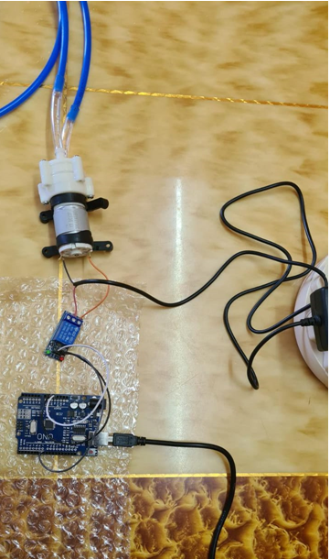
Motor Pump Circuit Code:
int in1 = 7;
void setup() {
pinMode(in1, OUTPUT);
digitalWrite(in1, HIGH);
}
void loop() {
digitalWrite(in1, LOW);
delay(3000);
digitalWrite(in1, HIGH);
delay(3000);
}
<- Circuit Connections

Slide 7
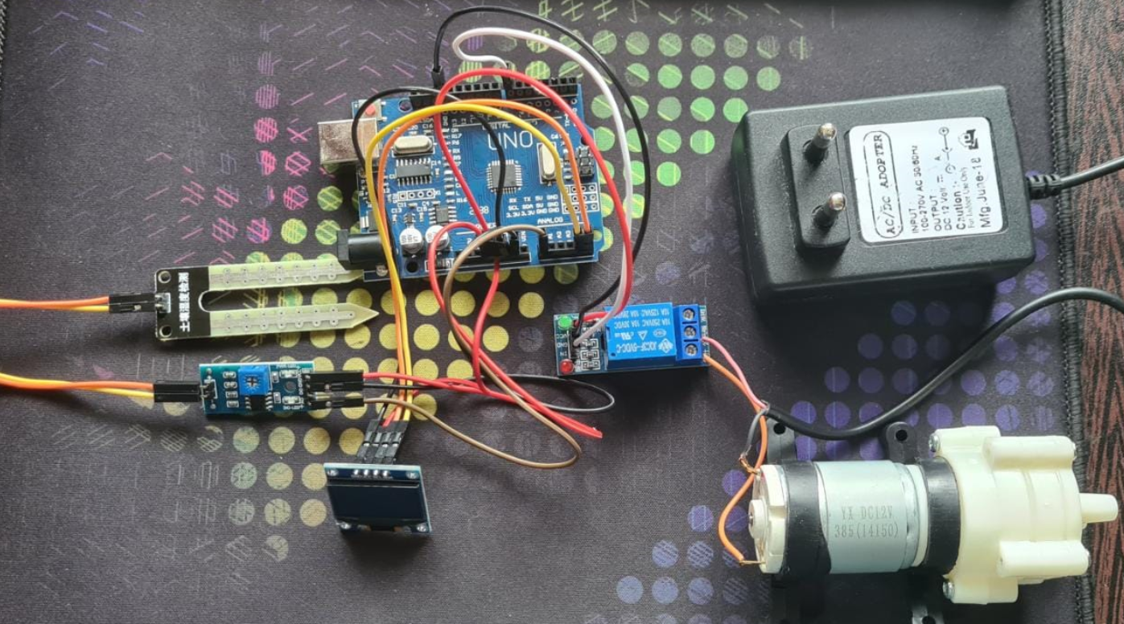
Overall Circuit Without SIM 800L:

Slide 8
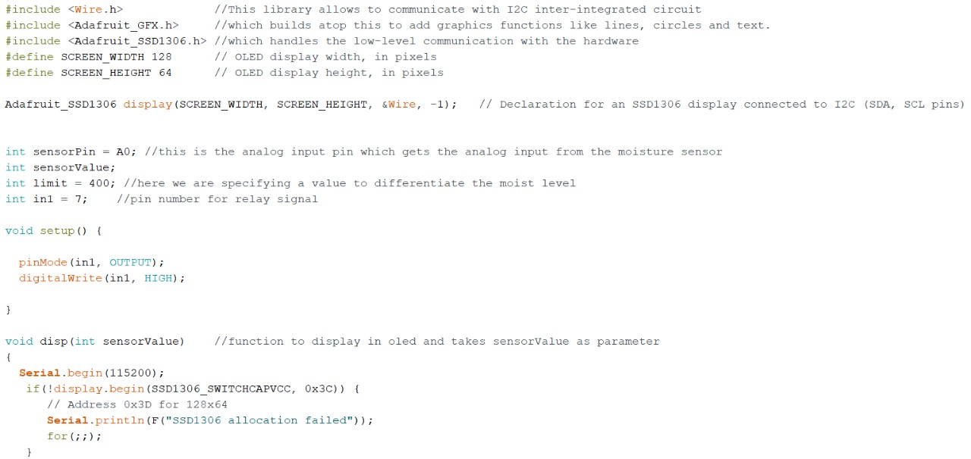
Complete Code :

Slide 9
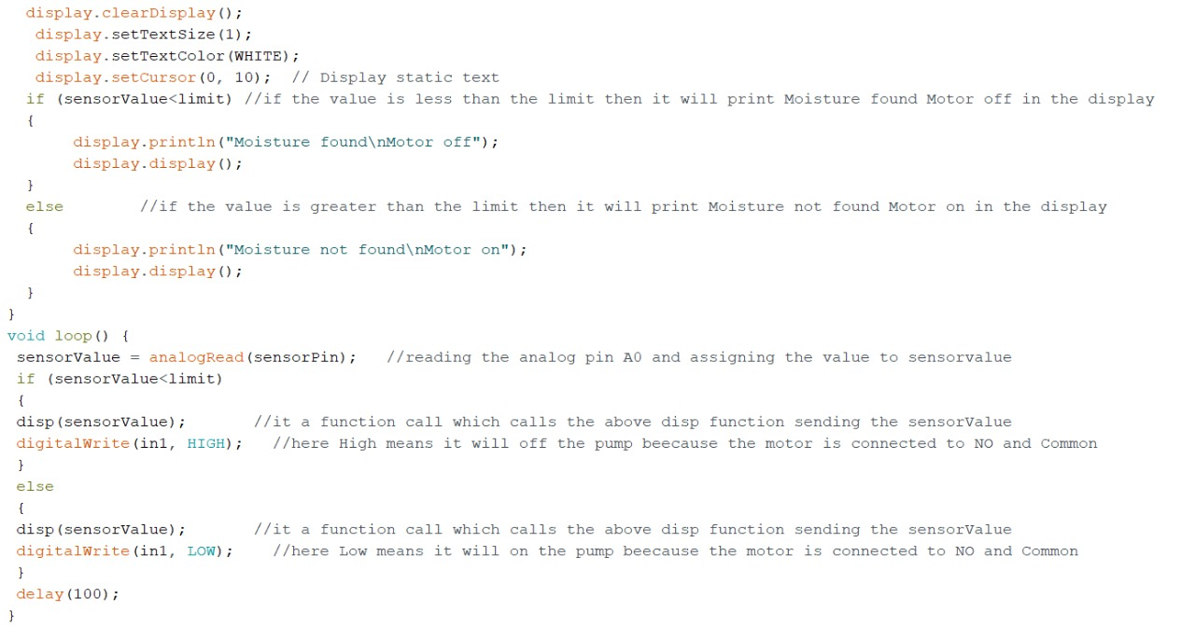

Slide 10
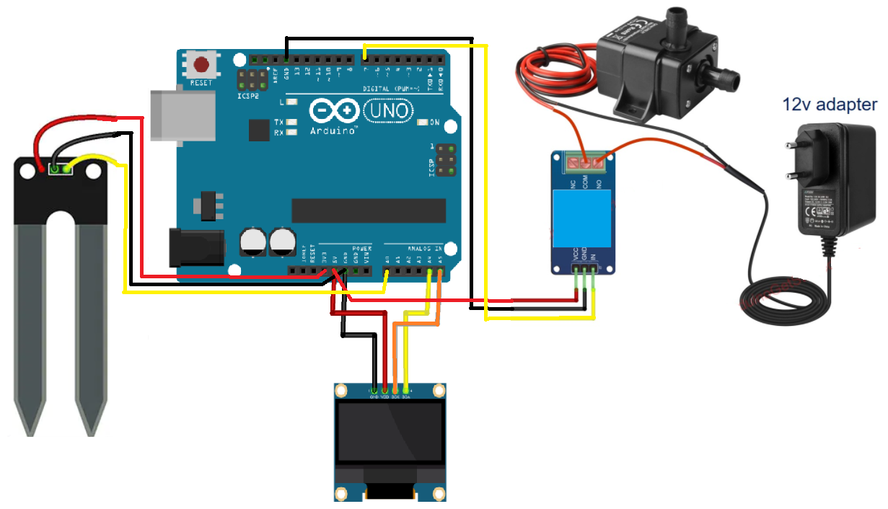
Overall Circuit:

